Slide 1

Lounge Eligibility Analysis & Demand Assumptions
Ayesha Nadaf, Data Analyst Intern
11/09/2025

Slide 2
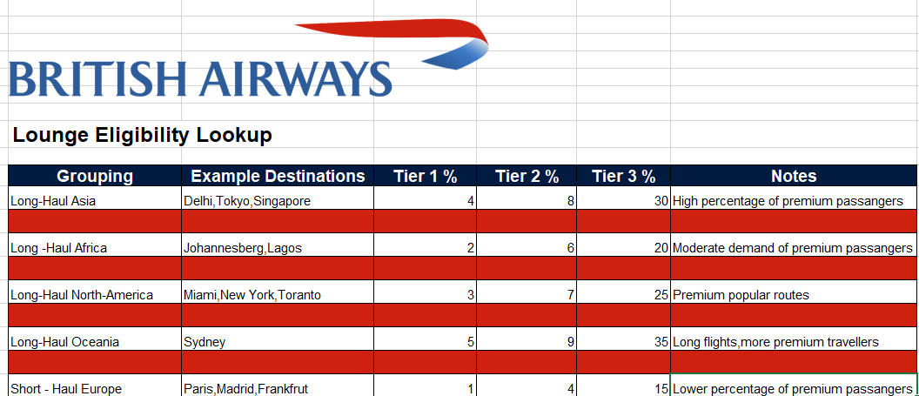
Lookup Table for lounge Eligibility and Demand
Key Insights:
High lounge demand on long-haul routes → Asia (30%), Oceania (35%), North America (25%).
Moderate demand in Africa (20%), showing regional differences in premium travel.
Low lounge usage for short-haul Europe (15%), less need for investment.
Tier structure consistent : Tier 1 exclusive, Tier 3 drives majority of demand.

